Slide 1


SIMATS ENGINEERING
SAVEETHA INSTITUTE OF MEDICAL AND TECHNICAL SCIENCES
MLA0408 - DEEP LEARNING
AI-Powered Personal Finance Management and Budget Recommendation System Using Deep Learning
Presented by
Nalipi Reddy Rohith(192425115)
G.J.D.Sai Sharan (192425152)
K Giridhar (192425160)
S Syed Abuzar(192425384)
Guided By
Dr. Sudhagar
Professor

Slide 2


INTRODUCTION
Managing personal finances can be challenging due to multiple income sources, expenses, and financial commitments.
Users often struggle to track spending, control unnecessary expenses, and maintain a balanced budget.
Unexpected expenses, changing financial goals, and irregular income can make financial planning difficult.
Our solution:
Develop a AI-Powered Personal Finance Management and Budget Recommendation System Using Deep Learning
Analyze users' income, expenses, and transaction history using deep learning techniques.
Help users achieve better financial planning, improve savings, and make smarter financial decisions.

Slide 3
SDG MAPPING
SDG 1: No Poverty
Supports better financial planning and savings, helping users improve their financial security and reduce the risk of debt.
SDG 8: Decent Work and Economic Growth Promotes responsible financial management, encouraging better budgeting, saving habits, and economic well-being.
SDG 9: Industry, Innovation and Infrastructure Applies Deep Learning and intelligent financial analytics to deliver innovative and personalized budget recommendations.
SDG 12: Responsible Consumption and Production Encourages responsible spending by analyzing user expenses and suggesting optimized budgeting strategies.

Slide 4
LITERATURE REVIEW
Author & Year | Research / Topic | Key Contribution | Limitation
M. Sharma et al., 2025 | Smart Personal Finance Assistant Using Deep Learning | Combined expense prediction, budgeting, and financial recommendations | Limited integration with multiple banking and payment platforms
R. Singh et al., 2024 | Expense Prediction Using LSTM Networks | Improved future expense forecasting using time-series analysis | Reduced accuracy with irregular spending behavior
A. Kumar et al., 2023 | AI-Powered Budget Recommendation System | Generated personalized budget plans based on transaction history | Performance depends on the quality of financial data
L. Chen et al., 2023 | Intelligent Financial Behavior Analysis | Identified spending habits and detected unusual transactions | High computational requirements for large datasets
J. Smith et al., 2022 | Deep Learning-Based Personal Finance Management | Applied deep learning to analyze spending patterns and predict expenses | Limited personalization for diverse user profiles

Slide 5
PROBLEM IDENTIFICATION
Managing personal finances has become increasingly challenging due to multiple income sources and daily digital transactions.
Users often struggle to track expenses, control unnecessary spending, and maintain an effective budget.
Existing budgeting applications mainly rely on manual inputs and provide limited personalized financial insights.
Unexpected expenses, irregular income, and changing financial goals make financial planning difficult.
There is no intelligent system that uses deep learning to analyze spending behavior, predict future expenses and provide personalized budget recommendations.

Slide 6
OBJECTIVES
To analyze users' income, expenses, savings, and transaction history using deep learning techniques.
To provide personalized budget recommendations based on individual spending patterns and financial goals.
To predict future expenses and identify unnecessary spending through intelligent financial analysis.
To help users improve savings, manage expenses efficiently, and achieve better financial planning.
To enhance financial decision-making by delivering accurate insights, automated recommendations, and real-time spending analysis.

Slide 7
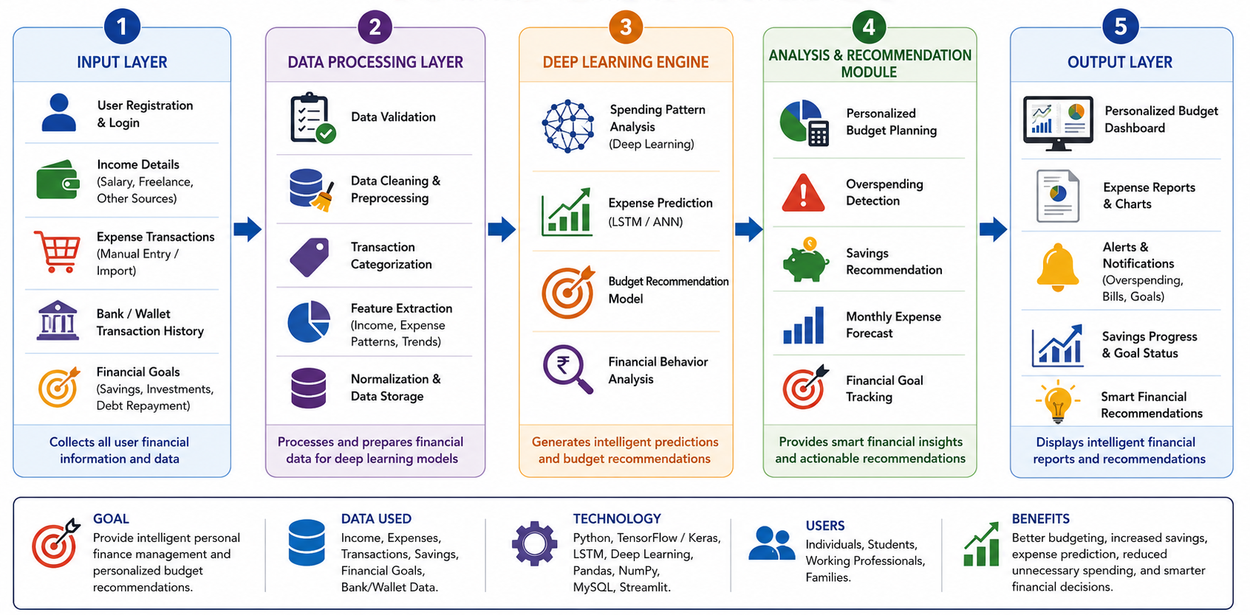
SYSTEM ARCHITECTURE

Slide 8

MODULE 1: USER & FINANCIAL DATA MANAGEMENT
Objective: To collect, store, organize, and manage user and financial data for secure, accurate, and personalized financial management.
Key Steps:
Collect user details: profile, income, expenses, savings, and financial goals
Store financial records in a structured database for efficient access and categorize transactions into income, expenses, investments, and bills
Validate and clean financial data to ensure accuracy and consistency
Maintain organized financial information for quick retrieval and analysis

Slide 9
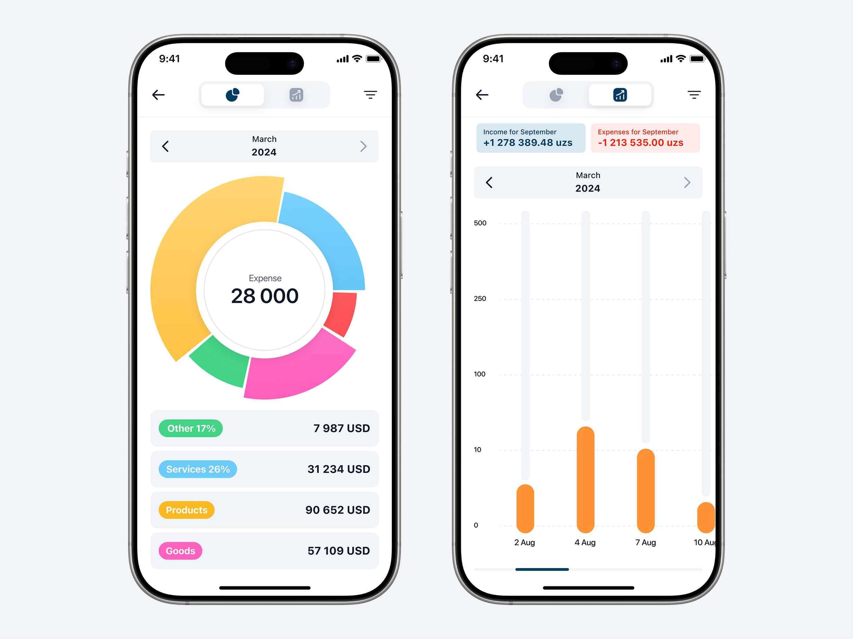
MODULE 2: SMART EXPENSE CLASSIFICATION & ANALYTICS
Objective: To automatically classify financial transactions and analyze spending patterns for better budgeting and financial decision-making.
Key Steps:
Collect and process user transaction data from multiple sources
Automatically classify expenses into categories such as food, transport, shopping, healthcare, and bills
Analyze spending trends using statistical and visual analytics
Detect unusual or excessive spending patterns through intelligent analysis

Slide 10
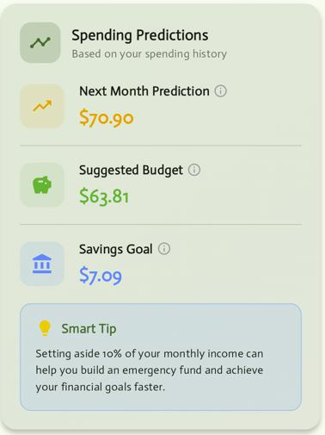
MODULE 3 DEEP LEARNING-BASED BUDGET PREDICTION & RECOMMENDATION
Objective: To predict future expenses and provide personalized budget recommendations using deep learning for effective financial planning.
Key Steps:
Collect historical income, expense, and savings data.
Preprocess and normalize the financial data.
Predict future expenses using the LSTM deep learning model.
Generate personalized budget recommendations based on predictions.
Continuously improve prediction accuracy with new transaction data.

Slide 11
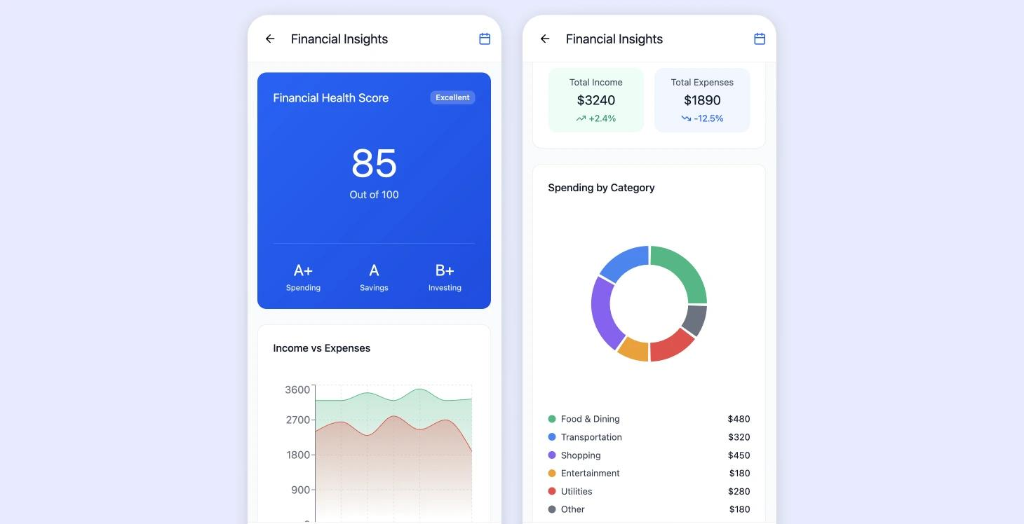
Module 4: Financial Health Monitoring & Reporting
Objective: To monitor users' financial health and generate reports for better financial planning and decision-making.
Key Steps:
Track income, expenses, savings, and investments.
Analyze financial health using key financial indicators.
Detect unusual spending and budget deviations.
Generate visual reports and financial summaries.
Provide insights to improve overall financial well-being.

Slide 12
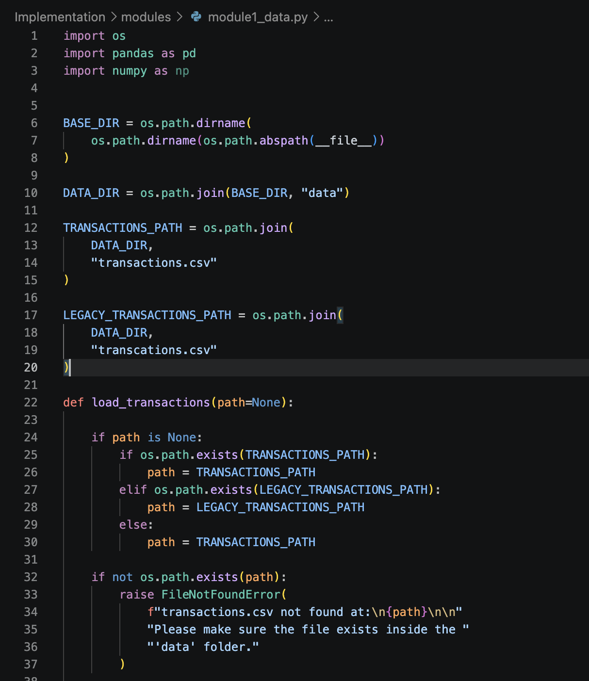
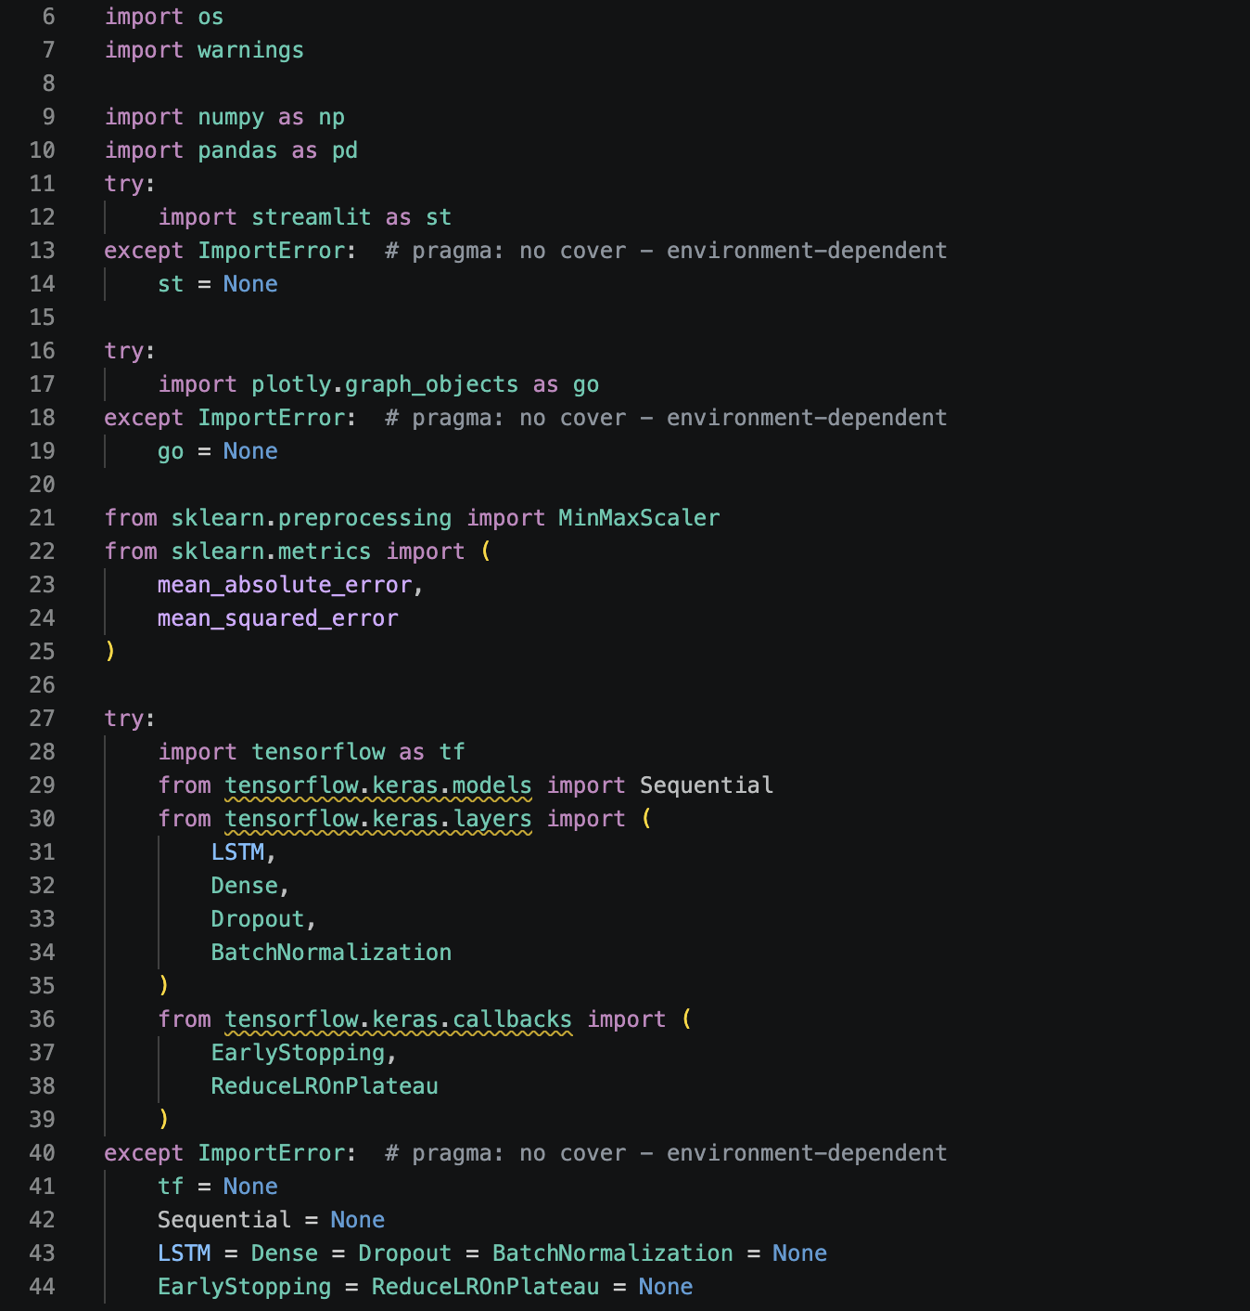
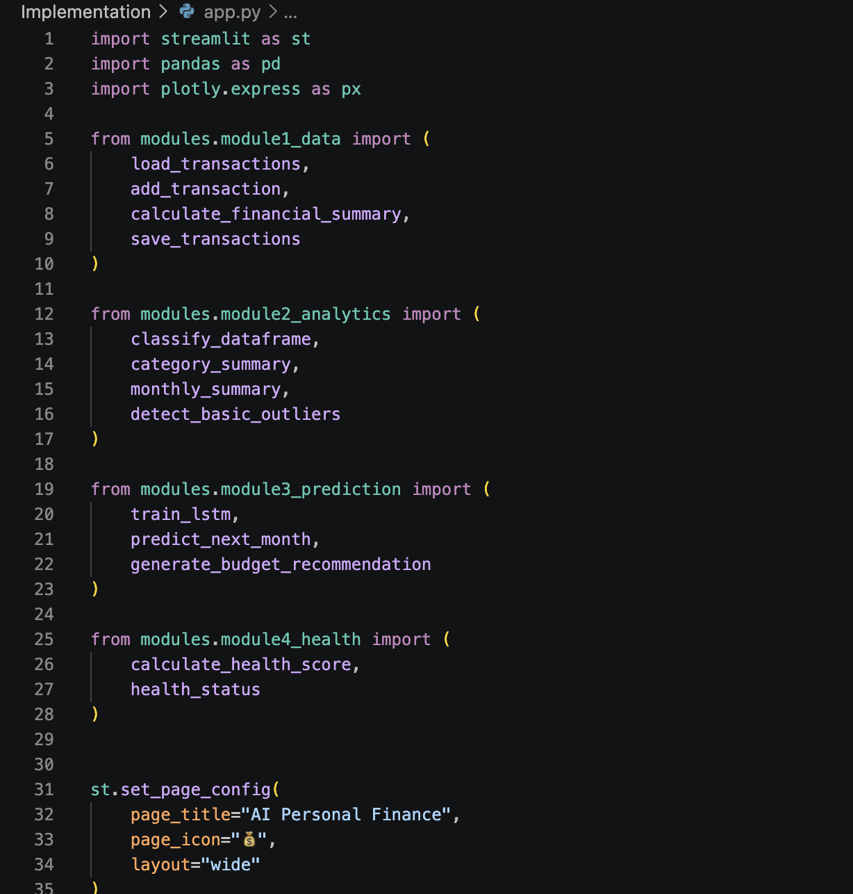
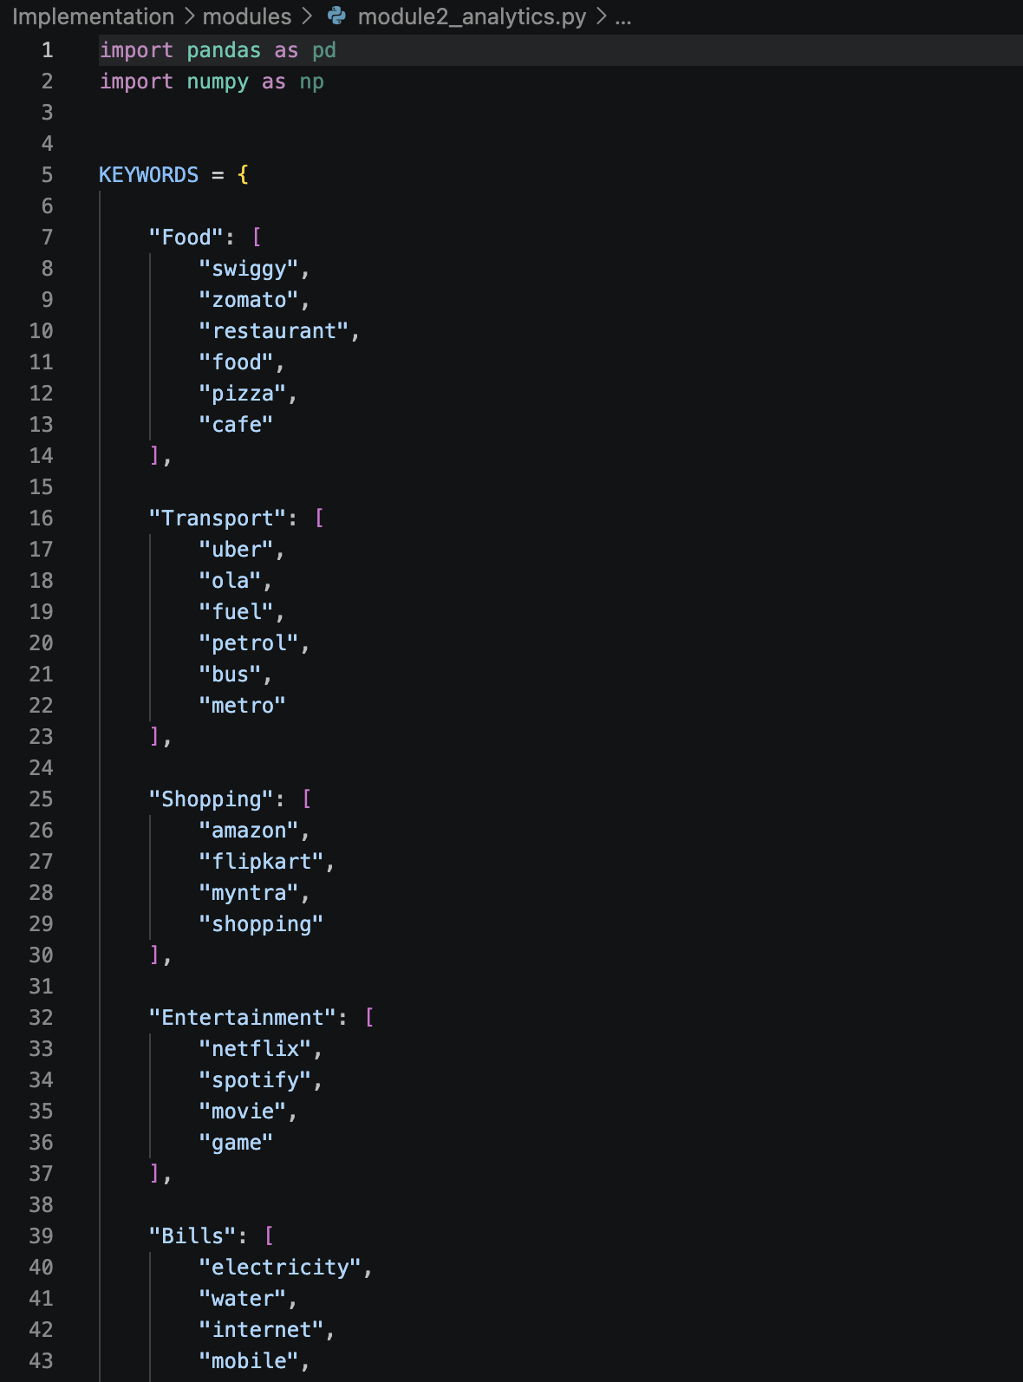
IMPLEMENTATION

Slide 13
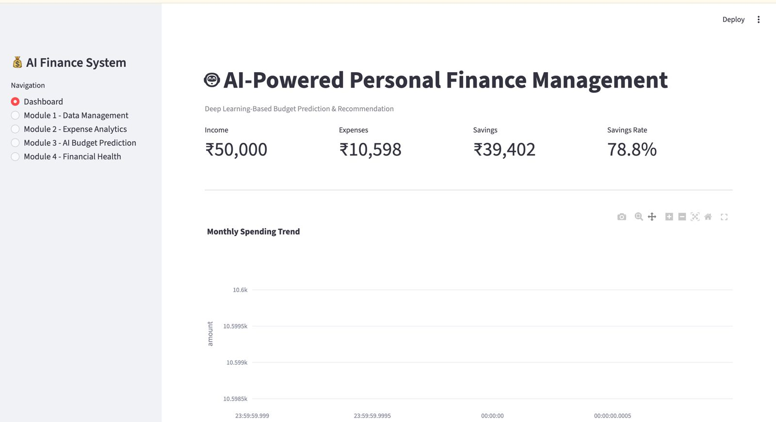
OUTPUT

Slide 14
RESULT AND DISCUSSION
The proposed system analyzes income, expenses, and transaction history to understand individual financial behavior.
Deep learning models improve future expense prediction by learning patterns from historical transactions.
Personalized budget recommendations help users allocate income efficiently and reduce unnecessary expenditure.
Spending analysis provides insights into high-expense categories, recurring expenses, and changing financial habits.
The system can identify unusual transaction patterns, improving financial awareness and monitoring.
Overall, the results demonstrate that AI can support automated and data-driven personal financial decision-making.

Slide 15
CHALLENGES & LIMITATIONS
Data Quality: Incomplete, inconsistent, or inaccurate transaction data can reduce prediction accuracy.
Irregular Spending: Unexpected expenses and changing spending habits make future expense forecasting difficult.
Personalization: Different users have different financial goals, income levels, and spending behaviors.
Data Privacy: Financial information is highly sensitive and requires strong security and privacy protection.
Platform Integration: Connecting with multiple banks, UPI services, and payment platforms can be technically challenging.
Model Complexity: Deep learning models require sufficient training data and computational resources.
Prediction Accuracy: Market changes, unexpected expenses, and limited historical data can affect forecasting performance.

Slide 16
FUTURE ENHANCEMENTS
Integrate with banks, UPI, credit cards, and digital payment platforms for automated transactioncollection.
Implement advanced LSTM, GRU, and Transformer models to improve forecasting performance.
Introduce real-time alerts for overspending, unusual transactions, and upcoming expenses.
Develop adaptive budget recommendations that change according to income and spendingbehavior.
Add savings and investment recommendations based on the user's financial goals.
Incorporate an AI-powered chatbot/voice assistant for interactive financial guidance.
Enhance security using encryption, authentication, and privacy-preserving techniques.

Slide 17
CONCLUSION
The proposed system provides an intelligent and personalized approach to personal finance management.
It combines expense prediction, spending analysis, budget planning, and financial recommendations in a unified platform.
Deep learning enables the system to learn from historical financial patterns and provide proactive insights.
The solution can help users control expenses, improve budgeting, increase savings, and make informed decisions.
With improved data integration and advanced AI models, the system can evolve into a comprehensive real-time personal financial assistant.

Slide 18
REFERENCES
[1] S. Hochreiter and J. Schmidhuber, “Long short-term memory,” Neural Computation, vol. 9, no. 8, pp. 1735–1780, 1997.
[2] I. Goodfellow, Y. Bengio, and A. Courville, Deep Learning. Cambridge, MA, USA: MIT Press, 2016.
[3] T. M. Mitchell, Machine Learning. New York, NY, USA: McGraw-Hill, 1997.
[4] C. M. Bishop, Pattern Recognition and Machine Learning. New York, NY, USA: Springer, 2006.
[5] F. Chollet, Deep Learning with Python, 2nd ed. Shelter Island, NY, USA: Manning Publications, 2021.

Slide 19
Thank You!

